Slide 1

Major Project –IA -1 Master of Computer Applications IV Semester – 2023
School of Computer Science and Applications

Slide 2
A PROJECT REPORT ON Application for the Senior citizen to monitor the auto fall due to health issue or unconscious issue.
Submitted IA-1 Project report completion of MCA degree
Presented by:
Mr. Manohar A S
SRN:R21DE131
Internal Guide : Prof. Dr. Setturu Bharath
External Guide : Prof. Shuaib Ahmed Shariff

Slide 3
Agenda
Global Certification (Attach soft copy certificate )
Internship certificate and details
Title of Major Project
Abstract
Software hardware Requirement
Existing system and Proposed system
Architecture Diagram
Module Description
Conclusion
Research Paper Details

Slide 4
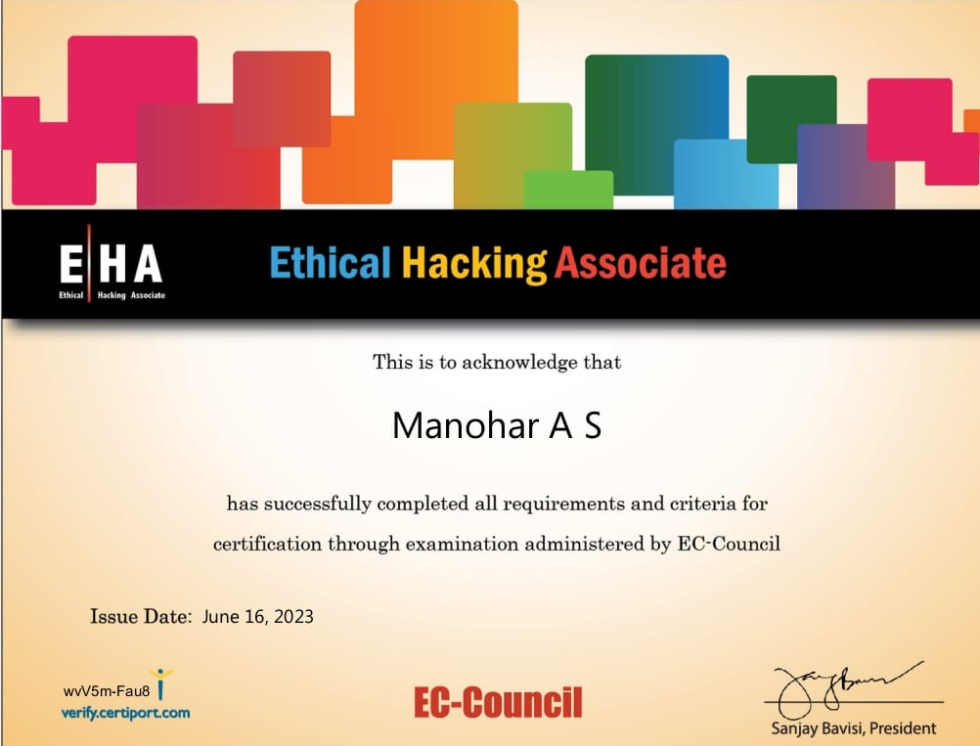
Global Certification

Slide 5
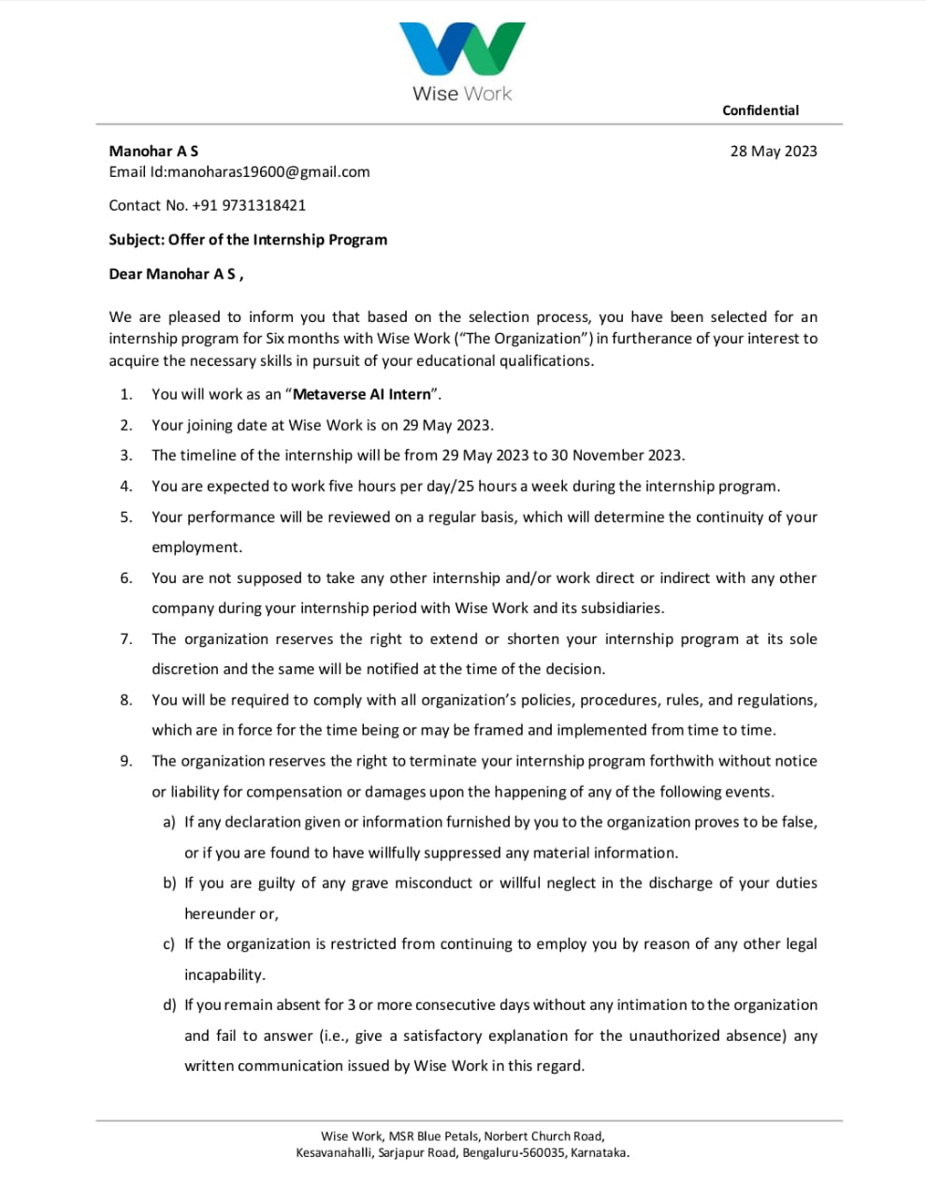
Internship certificate and details

Slide 6
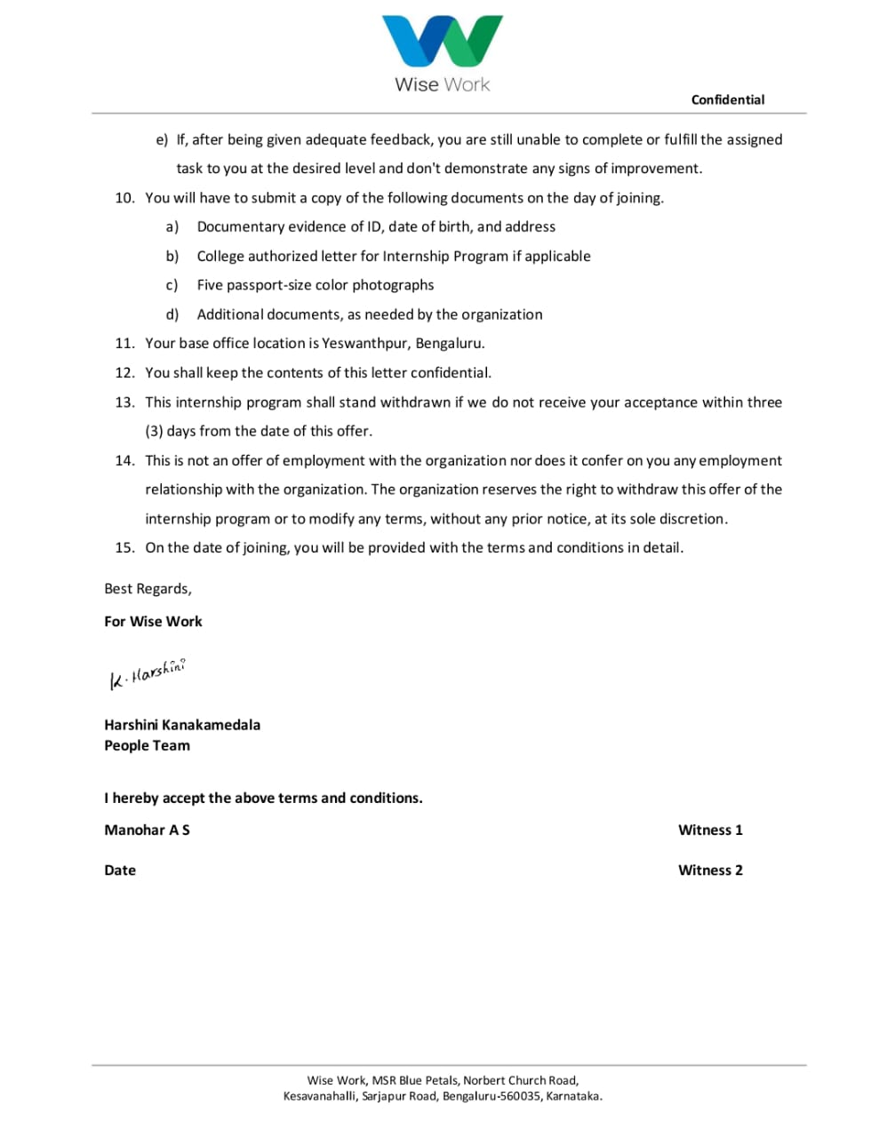
Internship certificate and details

Slide 7
Title of Major Project
Design the application for the Senior citizen to minor the auto fall due to health issue or unconscious issue using machine learning.

Slide 8
Abstract
Recently, the World Health Organization (WHO) reported that there are approximately 684,000 disastrous falls worldwide each year, with a majority of victims being individuals over the age of 60. Without a doubt, the injuries that elderly people sustain as a result of falls have far-reaching effects on their families, that is why fall detection technology in medical warning systems is such a critical and lifesaving feature.
The main aim of this application to migrate from the hardware bases elderly fall detection to the AI /Software based detection and cure.
The AI based application can be proven to be best based on the efficiency, and the result oriented. The IoT Module can result in wear and tear loss with unpredictable results.

Slide 9
Software hardware Requirement
.Software Requirements.
1 python
2.Spyder
3.Flask
4.Postman
5.Machine Learning
6. Image processing
Hardware requirements:
1. Window 7+
2. x86 64-bit CPU (Intel / AMD
architecture).
3. INTEL Processor
4.Amad processor
5.8GB RAM
6.System Integrated Camera

Slide 10
Existing system
The diagnosis and treatment of disorders and health monitoring is crucial. Fall detection devices, for example, can help detect anomalies and transmit real-time signals to health and social care professionals about the abnormalities.
There are few existing systems which help the problem, but they are not physically implemented yet.
Artificial intelligence gives the system the ability to detect falls based on the dataset and data trends. Sensors produce data connected with various fall parameters during the data collection procedure. As a result, machine learning methods are utilized to categorize or identify fall actions based on the requirements of an application.
The Internet of Things (IoT) is a relatively new technology that has great potential for developing a fall detection system. To construct fall diagnosis systems, this emerging technology could supply data processing, communication channels, and smart sensors.

Slide 11
Proposal system
Digital platform for the guardian to monitor the application.
1. the proposed system is The GUI based Application which make user to run the application to detect
2. It is the Desktop application with the integrated hardware.
3. In our proposed system we implemented
3.1 Flask Authentication module to create account for new user
3.2 Open CV to capture the real time image.
3.3 Machine Learning to detect the movement of the object/person to detect the fall.
3.4 Notification System to alert to the Guardian for any now-Accurate circumstances.

Slide 12
Architecture Diagram

Slide 13
Module Description
Guardian Registration
Guardian Login
Capture Realtime image
Track the movement of object.
Upload the elderly person details.
Send email or notification to the guardian.
Auto Alert Generation
AI image morphing

Slide 14
Conclusion
The development of an application utilizing machine learning for senior citizens to monitor and detect auto falls due to health or unconscious issues holds great potential in enhancing their safety and well-being. By leveraging advanced algorithms and sensor data, the application can proactively identify falls and alert emergency contacts or caregivers, ensuring prompt assistance and reducing the risk of severe injuries. This technology has the capacity to significantly improve the quality of life for senior citizens, offering peace of mind to both them and their loved ones.

Slide 15
Thank You

Slide 16


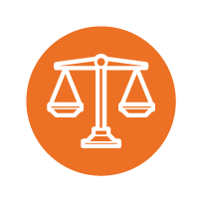




Icons
Architecture
Commerce
Legal Studies
Arts & Humanities
Performing Arts
Management Studies
Science & Tech
Engineering

